Slide 1
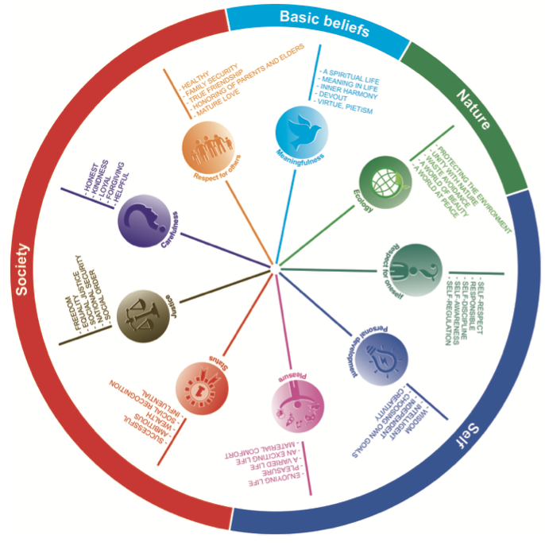
Stakeholder & value
Stakeholder & value
Stakeholder & value
Stakeholder & value
Stakeholder & value
Notes:
Mind you, this is really perceived from the end users as a stakeholder. But feel free to include other stakeholders to observe value tensions. For instance freedom of speech can be troublesome for YouTube

Slide 2
Nerd & independent
Fattie & Pleasure
Nerd & Pleasure
Hippie & enviroment
Hippie & meangfull
Hippie & Justice
Fattie & Justice
Hippie & healthy
Fattie & Honesty
Notes:
Mind you, this is really perceived from the end users as a stakeholder. But feel free to include other stakeholders to observe value tensions. For instance freedom of speech can be troublesome for YouTube

Slide 3
Stakeholder & value
Stakeholder & value
Stakeholder & value
Stakeholder & value
Stakeholder & value
Notes:
Mind you, this is really perceived from the end users as a stakeholder. But feel free to include other stakeholders to observe value tensions. For instance freedom of speech can be troublesome for YouTube

